Slide 1


Name: Aman singh
Enrollment number: EBEON0123736982

Slide 2
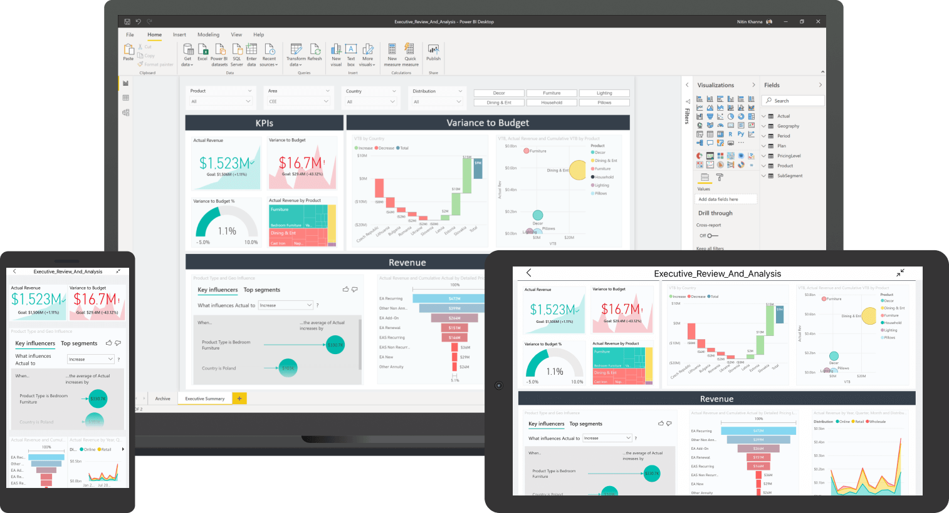
Power BI
Microsoft Power BI is a business intelligence (BI) platform that provides nontechnical business users with tools for aggregating, analyzing, visualizing and sharing data.
For the project we are using Sample Superstore Data.

Slide 3
Process of making power bi dashboard
Power BI
Importing the data
Cleaning the data
Arranging the data

Slide 4
Tools Used IN POWER BI
SLICER
BAR CHART
LINE CHART
CARD
FILLED MAP / DONUT CHART
KPI

Slide 5
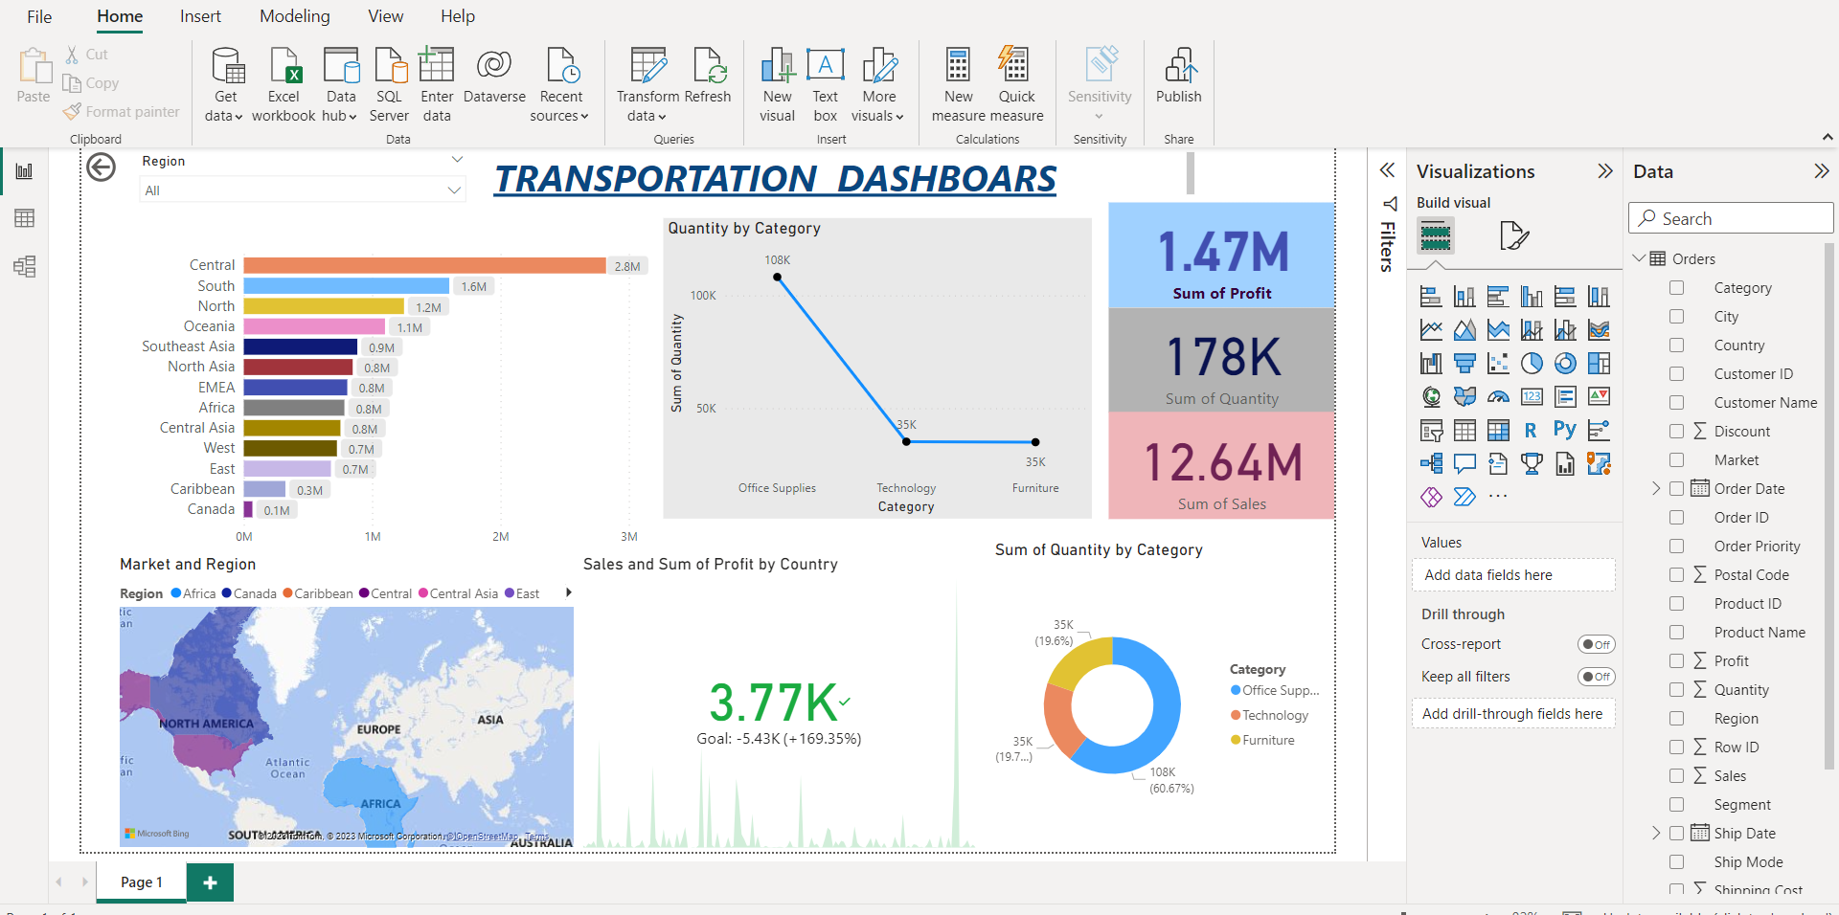
PowerBI Dashboards

Slide 6

Tableau
Tableau is a visual analytics platform transforming the way we use data to solve problems—empowering people and organizations to make the most of their data.

Slide 7
Tools Used IN Tableau
Tableau
Importing the data
Cleaning the data
Arranging the data

Slide 8
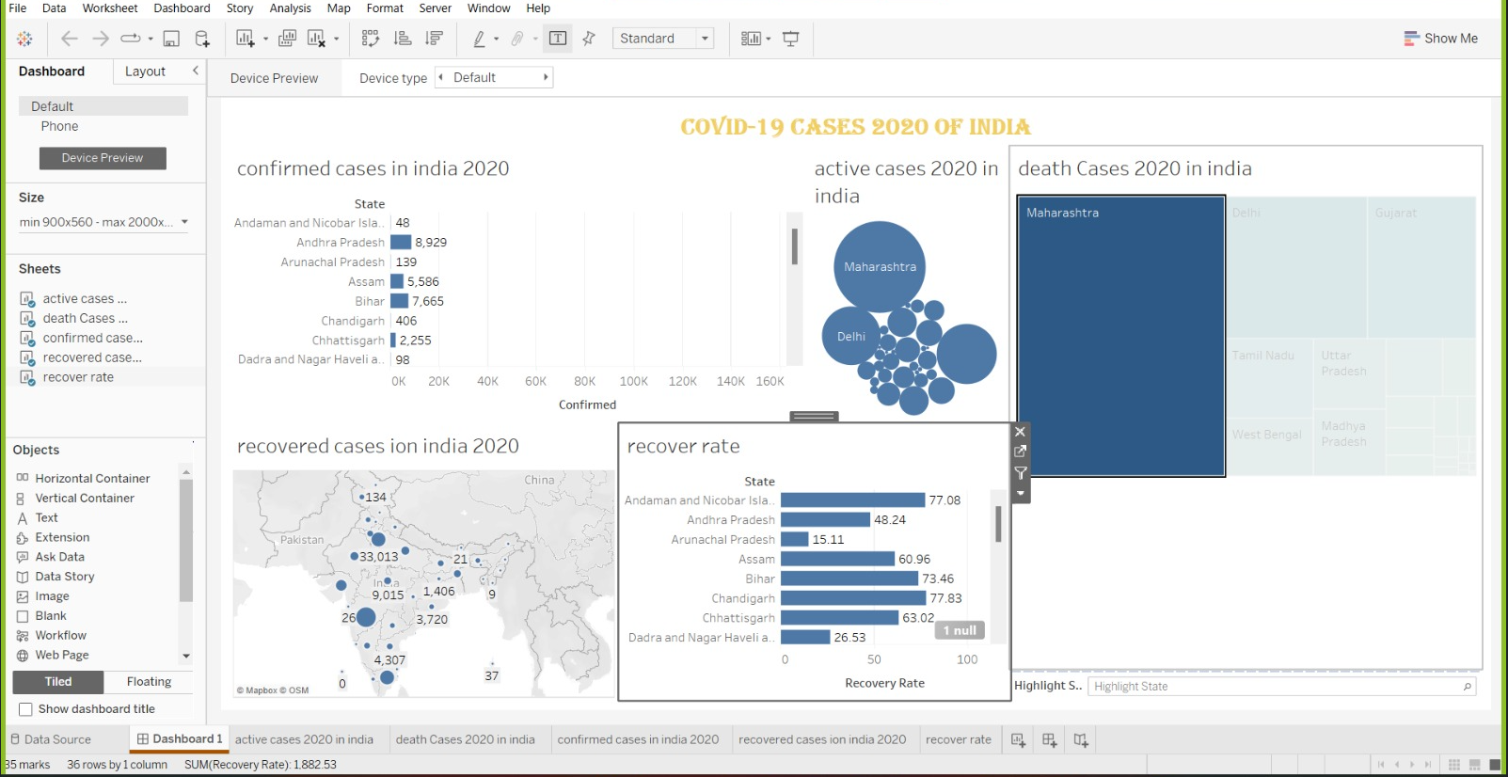
Tableau dashboard

Slide 9
Enrolment number – 1
Tools & software used-2
Contents-3
Screenshot of dashboards-4
Graphes-5

